Slide 1
A Sample of Observational Restraint Use on Navajo Nation
As part of the Annual Safety Belt Use Estimate for the Indian Nations
May 21, 2024
Robert H. B. Chaffe
Preusser Research Group, Inc.
Notes:
We are a highway safety research firm currently under contract with the BIA to measure seat belt use on tribal roadways.

Slide 2
Background
In general, seat belt use on tribally-enforced roadways has lagged behind use rates measured on non-tribally-enforced roadways.
Unintentional injuries sustained by motor vehicle crashes are the leading cause of death for Native Americans aged 1 to 44. (CDC)
From 1975 to 2002, over three-fourths of the vehicle occupants who died in motor vehicle crashes on tribal lands were unrestrained at the time of impact. (DOT/NHTSA)
In 2004, NHTSA/BIA co-sponsored a project to (a) establish the first baseline tribal roadway use rate and (b) develop a sample and methodology for future use.
Notes:
First, a little background leading into why this survey was proposed in the first place…bullets 1-3
Read for 4th bullet: The National Highway Traffic Safety Administration (NHTSA) and the Bureau of Indian Affairs (BIA) Indian Highway Safety Program, co-sponsored a project in Fall 2004 to (a) establish the first baseline tribal roadway safety belt use rate, and (b) develop a methodology for use in the future to track trends. NHTSA enlisted PRG to design and develop a survey – with a sample that would be representative of all traffic on tribally-enforced roadways nationwide.

Slide 3
Method - Sampling
Sample was from nationally recognized lands with:
  Populations of 2,000+;
  Varying environmental conditions;
  All areas of the country included; and
  Enough sites per tribal land for a reliable measure.
Notes:
The sampling procedure weighted all tribal lands proportional to their populations, and it included the criteria that the sample of tribal lands must have (bullet list) : “populations…”
After bullets: Ultimately, the planned sample included 18 tribal lands over 6 “regions” - with 151 total site locations.

Slide 4
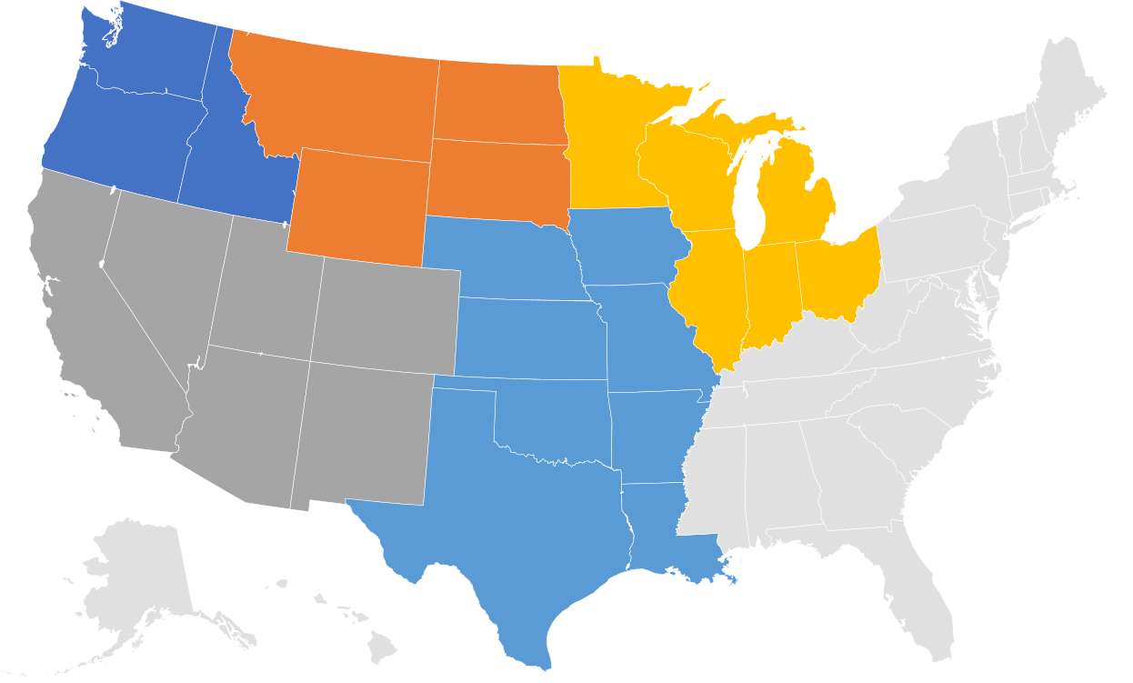
Method - Sampling Regions
Notes:
Representation from 6 regions is population based:
Southwest
South Central
South & East
Northwest
Northern Plains
Great Lakes

Slide 5
Method - Observation Site Selection
Number of sites assigned per selected tribal land was proportionate to its population. For Navajo Nation that number was determined to be 27.
Sites were spread across 5 distinct population centers (Shiprock, Window Rock, Chinle, Kayenta and Tuba City)
The 27 sites were not intended to be fully representative of Navajo, and the results do not represent official rates.
Notes:
As for as the selection of sites…..1st Bullet point, then read this for the other 2: These sites were randomly-selected before our initial measure in Navajo, and the same locations have been used every iteration since. Sites include roadside locations within 5 distinct population centers (“collectors”) in Navajo Nation, as well as roadways providing access in and out of the centers (“arterials”).
The 27 sites are only an index sample, so any results presented here do not represent official Navajo use rates. However, the results can be informative – and useful for tracking program effects - when trended out over time.

Slide 6
Navajo Nation Data Collection
Data were collected periodically since 2010 (annually 2010-2012, then again annually from 2015-2022). Data were not collected in 2023
The slides that follow summarize results from the Navajo collections, initially focusing on 2022 findings.
Data were recorded for drivers and front seat passengers only, including vehicle type driven, occupant sex, and occupant belt use.
Notes:
Navajo’s involvement in the survey began in 2010, and data were collected annually through 2012, then again annually from 2015-2022. Data were not collected in 2023 as the contract with BIA ended. A new contract between PRG and BIA was awarded in 2024, thus we are asking to resume the annual measure.
What follows summarizes results from these Navajo collections, primarily focusing on the 2022 results – though we will look at some trends. All surveys were conducted by Preusser Research Group, Inc. (PRG), under contract with the Bureau of Indian Affairs (BIA). Let me point out that we do NOT report out individual tribal land findings to BIA. We only share those results with the tribes that request them.
Data were recorded for drivers and front seat passengers for one hour at each site. These were unobtrusive observations in that the observer recorded data at roadside as motorists passed by in moving traffic. Data recorded included vehicle type, driver/passenger sex and driver/passenger seat belt use.

Slide 7
2022 Navajo Survey Demographics
2,899 front seat occupants (2,126 drivers and 773 passengers).
1,484 were male and 1,415 were female
1,007 were in cars; 938 in pickups, 831 in SUVs, and 123 in vans
2,201 were observed on arterial roadways; 698 were observed on “in-town” collectors
Notes:
This slide gives some overall numbers – or counts – for the 2022 collection:
Observation data capturing belt use were recorded for 2899….
(“arterials”) - roadways providing access in and out of the centers

Slide 8
2022 Navajo Raw Use Result
Overall raw belt usage for all Navajo Nation occupants in August 2022 was 80.5 percent.
Result is 0.3 percentage points lower than the most recent previous measure of 80.2 percent in August 2021.
(non sig @ p = .05)
2022 result is only 0.7 points below our highest level measured in August 2016 (80.9 percent).
Notes:
Now I’ll go into some results: Overall raw belt use for all occupants in 2022 was 80.5 percent. This rate is 0.3 percentage points higher than the August 2021 measure of 80.2 percent, but the difference is not statistically significant (at p = .05). The 2022 rate is just 0.7 percentage points lower than our all-time-high measure of August 2016 (80.9 percent).

Slide 9
2022 Raw Usage by Group
Driver usage was 79.7 percent (n=2,126); Passenger use was 82.7 (n=773).
Male Usage was 78.4 percent (n =1,484) while Female Usage was 82.5 percent (n =1,415).
Truck occupant usage was at 72.0 percent , while cars, SUVs and vans all had usage in the 80s (83.0, 86.4, and 84.6 percent respectively).
Arterial usage was 84.0 percent, while Collector usage was measured at 69.3 percent.
Notes:
On to some usage by group results: Like in most years, observations this iteration indicated that passenger belt use was slightly higher than driver belt use (82.7 vs 79.7%).
As usual, observations indicated female occupant belt use was higher than male occupant belt use.
Observations indicated use in pickup trucks was -and has always been - substantially lower than usage in other vehicle types. Belt use was at least 80 percent in all other vehicle types
As mentioned before, sites were divided among in-town roads and in-between town roadways. Observations indicated occupant belt use on arterial segments was much higher than usage on collectors.

Slide 10
Year to Year Comparisons of Raw
Occupant Belt Usage in Navajo by Group
Notes:
This fairly large table shows differences in observed belt use from year to most recent year, broken down by occupant groups.
Increases in usage from 2021 were shown across about half of categories of occupants (with the greatest being the 2.9 percentage point difference among SUV occupants), but there nearly as many decreases in usage as well (particularly among occupants in pickup trucks). It is important to keep in mind that sample sizes are small when broken down to these levels - and the fact that most year-to-year changes in usage are non-significant (@ p = .05, only the decrease in usage among truck occupants was significant). Trending out the data by category over multiple years is the best way to identify change over time.

Slide 11
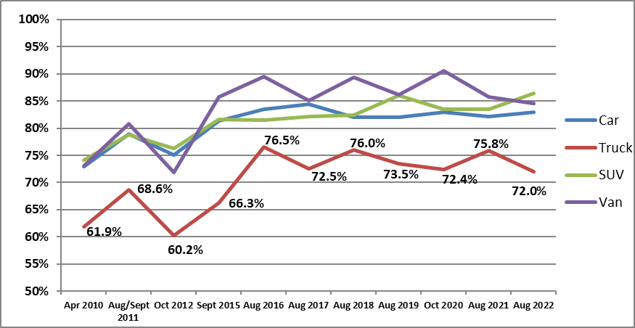
Navajo Seatbelt Usage Trends
Vehicle Type
Notes:
Now let’s look at some trends:
This Figure depicts overall raw belt use rates for occupants by vehicle type across the nine measurement periods going back to 2010.
Restraint use by occupants in pickup trucks still lags below the use levels in other vehicle types.

Slide 12
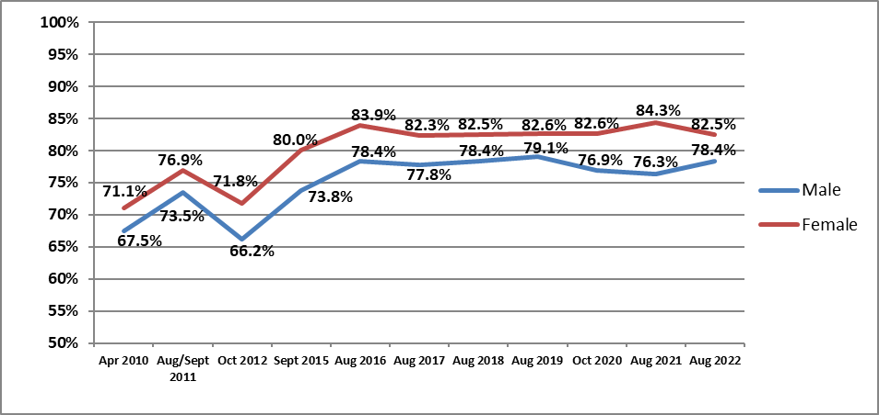
Navajo Seatbelt Usage Trends
Sex
Notes:
This graph shows the trend of overall raw belt use rates for occupants by sex across the 11 measurement periods.

Slide 13
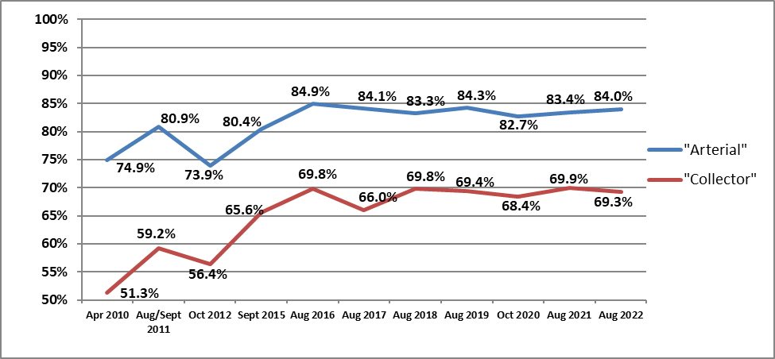
Navajo Seatbelt Usage Trends
Roadway Type
Notes:
This slide shows a significant gap in usage among occupants travelling in-town versus those on arterials. This is not unusual to see as, in general, enforcement is more present on the higher speed roadways, trips are longer in duration, and perceived risk of injury is greater, thus occupants are more likely to buckle up.
Overall, usage on collectors appears to be improving over time, but it still greatly lags the use rate among arterial-travelling occupants.

Slide 14
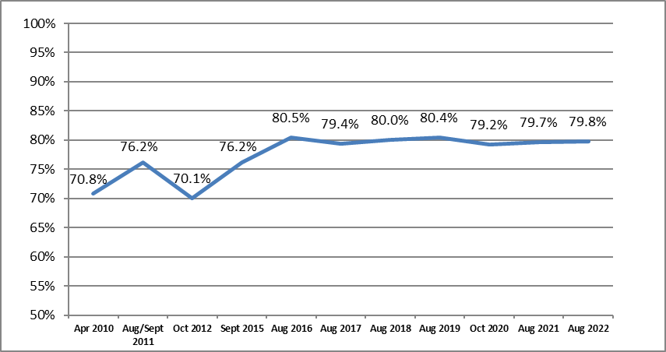
Navajo Seatbelt Usage Trends
Weighted Rate
Notes:
Lastly, here is trend graph of the weighted belt use rate for Navajo Nation. Weighted rates are calculated each year for all reservations measured and reflect the volume and road type of each site location. A more detailed description of how these rates are calculated can be found in our report to the Bureau of Indian Affairs. Navajo has been statistically the same since 2016.

Slide 15
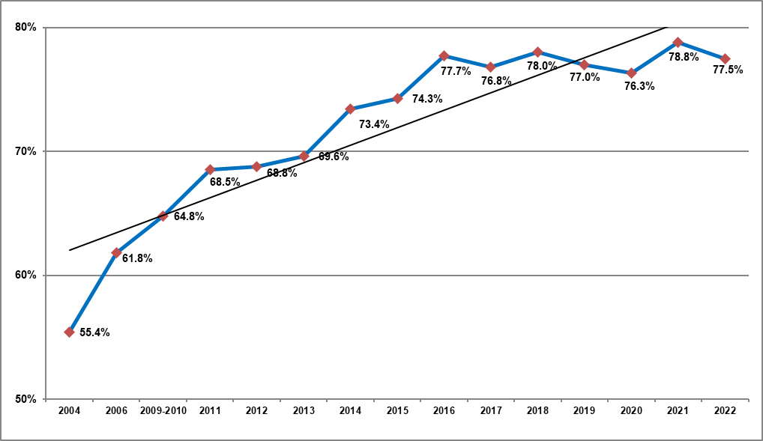
National Tribal Roadway Usage Trend
Weighted Rate
Notes:
Finally, for comparison’s sake, here is overall trend graph of the weighted belt use rate for entire Nationwide Survey. These rates were calculated from data collected in 17 different tribal lands (16 lands in those years we did not measure in Navajo). You can see over time how usage is mostly trending upward (until recently), and you may notice that the levels are slightly lower than the rates calculated for Navajo Nation. However, most of the trends we see in the overall dataset apply to Navajo as well (lower use among males, in trucks and on collectors)

Slide 16
Summary
2022 marks the 11th time belt use has been measured in Navajo Nation as part of the nationwide estimate for the BIA
The same 27 sites were measured for each iteration
Navajo Nation is maintaining its highest usage levels since measurements began in 2010, and usage overall remains higher than the national tribal roadway estimates, but there are some parallels among the two sets of data:
  Lower use among males, truck occupants, travelers on collectors
  Pickup truck occupants represent a fairly large proportion of the sample (n
  Occupants on collectors are the group with the lowest usage rate
Notes:
So, in Summary:
The 2022 observations in Navajo Nation represent the 11th inclusion of Navajo in the larger nationwide estimate for the Bureau of Indian Affairs.
The same 27 sites within Navajo have been measured for each iteration. The sites measured are only an index sample, so any results presented today do not represent official Navajo use rates. However, trending out this data can still serve as an indicator of change.
Data collected from 2022 indicate that belt usage in Navajo Nation is among its highest levels since measurements began in 2010. O. Navajo Nation safety belt usage generally remains higher than the national average for usage on tribally enforced roadways.
However, certain groups of occupants warrant further attention when educating about and enforcing belt laws – particularly males, occupants of pickup trucks (which represent a fairly large proportion of the sample), and travelers within town centers - though a multi-year trend suggests improvements over time.
The group in most need of improvement appears to be occupants travelling on collectors. The perception that wearing a belt is less necessary on short trips within town is apparent, but serious injury or fatal crashes can occur anywhere and anytime under a variety of circumstances.

Slide 17
Questions?
Robert H. B. Chaffe
Senior Research Associate
Rchaffe@PreusserGroup.com
662-236-9288

